Slide 1
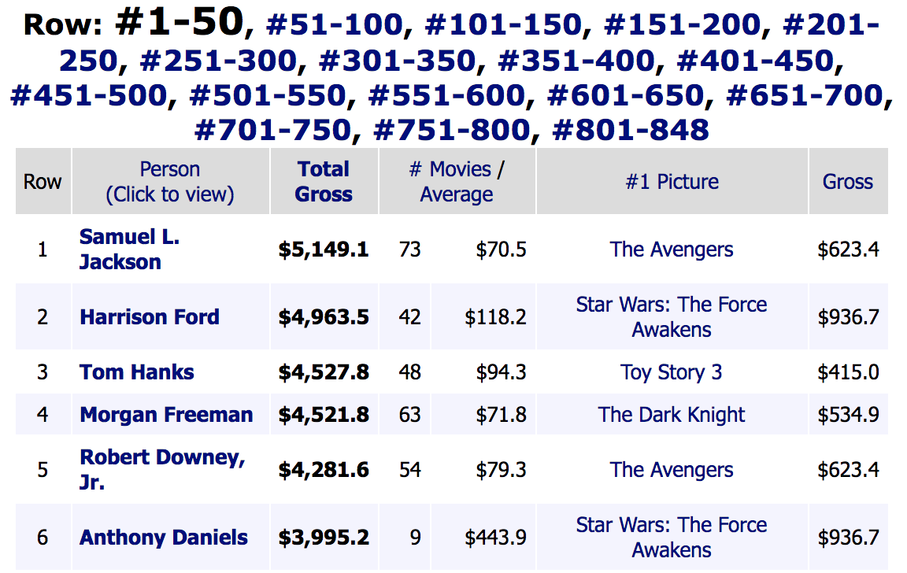
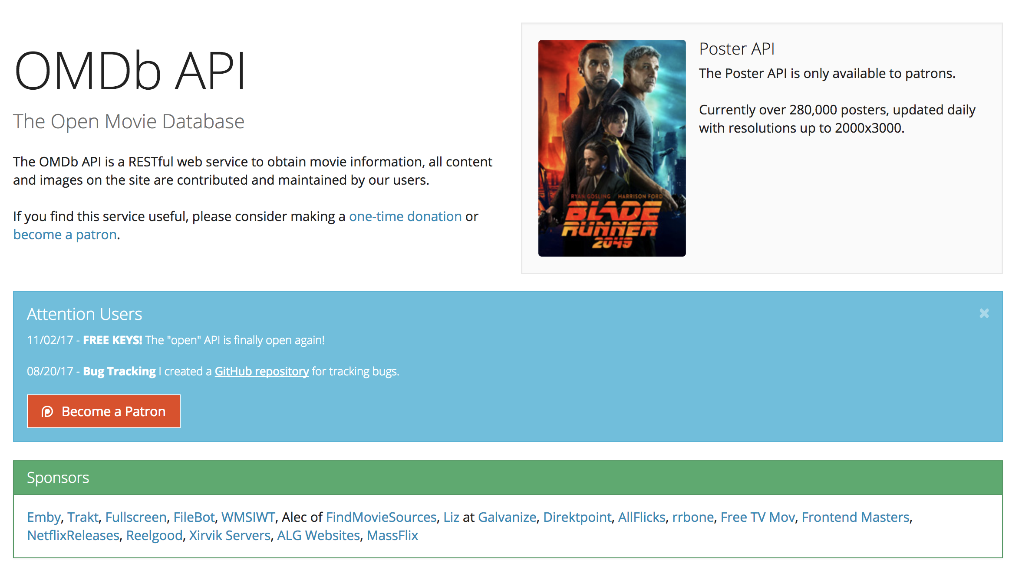
Three main sources
Source: http://www.boxofficemojo.com
Mojo Box office
OMDB API
IMDB
Source: http://www.omdbapi.com

Slide 2
Collecting process
I/O intensive tasks
Multi-threading
Scraping and querying
Store in csv

